Slide 1
Online Customer Intention Prediction
Ashish Kumar
IBM Advance Data Science Capstone

Slide 2
Use Case
Model user behavior based on their interactions with an e- commerce website
Measure which website actions correlate with revenue and sales
Identify seasonality and trends in buying behaviors

Slide 3
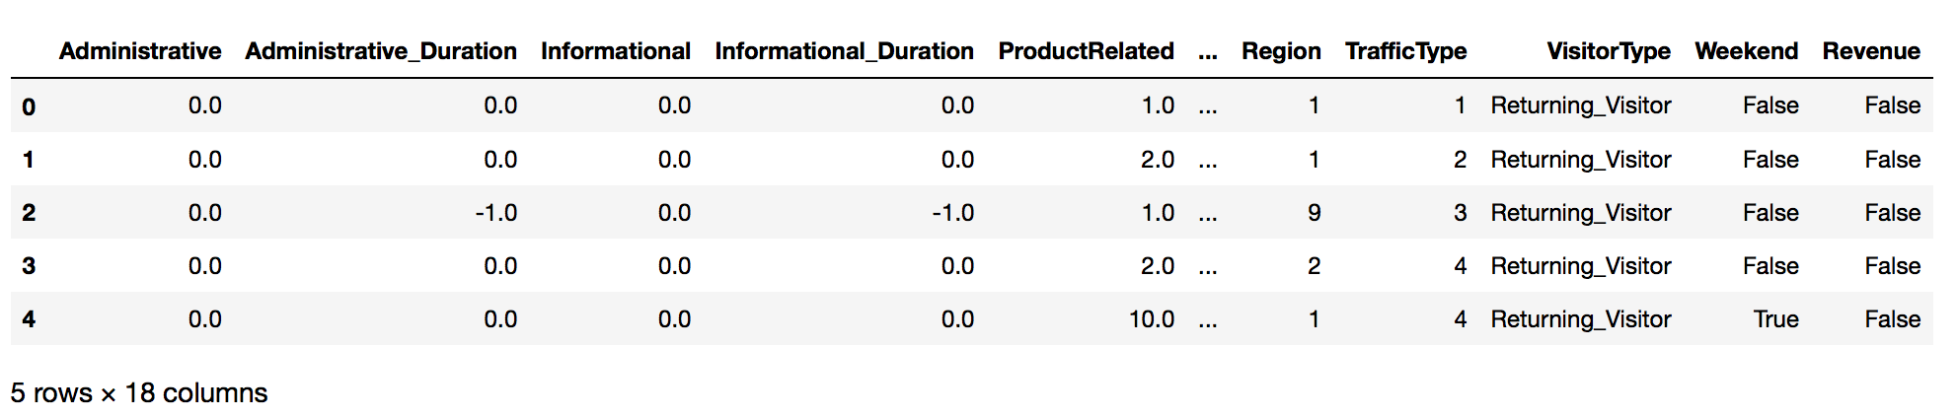
Dataset
The dataset was obtained from Kaggle (https://www.kaggle.com/roshansharma/online-shopper-s-intention)
Dataset consists of 12316 samples and 18 features of which 8 are categorical and 10 are numeric

Slide 4
Data Quality Assessment
The Data consists of 0.11 percent Missing values
Some duration values were negative suggesting outliers or missing values
The numerical features are highly skewed.
The Prediction classes are imbalanced with 1908 True and 10422 False classes

Slide 5
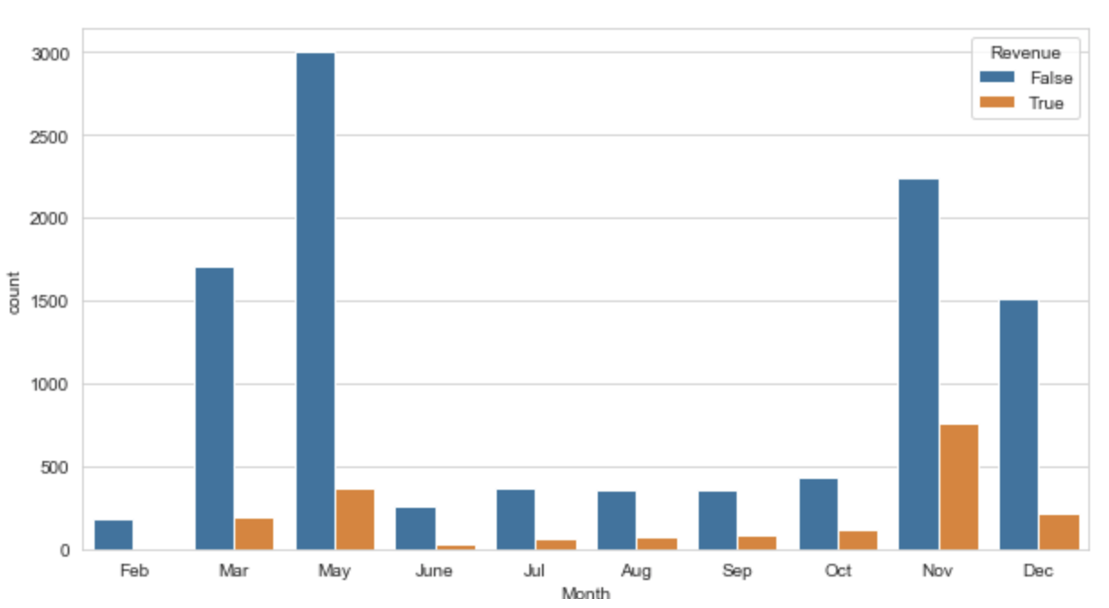
Exploration and Visualization

Slide 6
Feature Engineering
Missing values were dropped
Each numerical values was clipped to remove outliers
Categorical variables were One Hot encoded
Three different feature sets were generated
1. No scaling
2. Scaled using MinMax scaler
3. Yeo Johnson transformation

Slide 7
Model Performance Indicator
To handle imbalance of classes Balanced accuracy score was used
Balanced accuracy is calculated as the average of the proportion corrects of each class individually.

Slide 8
Model Selection
Two models were uses:-
1. Gradient boosted tree implemented with LightGBM
2. Deep Neural Network implemented with Keras
Hyper-parameters For each models were optimized using Bayesian optimization
The models were evaluated on all 3 three feature sets.

Slide 9
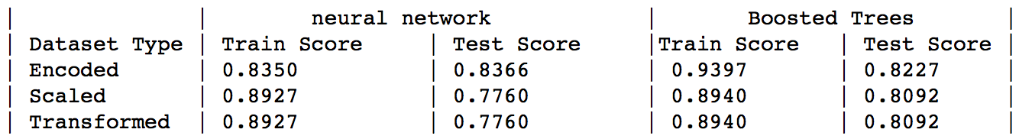
Results

Slide 10
Conclusion
Dataset was cleaned , explored and visualized
Three transformations were tested and applied
Two models were trained
Top 10 correlating features were isolated

Slide 11
Thank You

